Slide 1
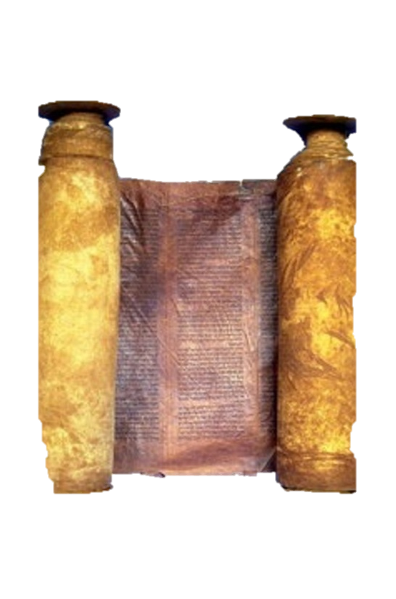
A free CD of this message will be available immediately following the service
1 Kings
1-2
A podcast will also be available later this week at calvaryokc.com

Slide 2
David in Wilderness
David as King
Solomon as King
Divided Kingdom
1 Samuel
2 Samuel
1 Kings
2 Kings
1 Chronicles
2 Chronicles
1 kings 1-2

Slide 3
1 kings 1-2

Slide 4
Not get warm ~ KJV, gat no heat
1 kings 1-2

Slide 5
1 kings 1-2

Slide 6
Exalted ~ literally, was exalting
1 kings 1-2

Slide 7
1 kings 1-2

Slide 8
Face ~ literally, nostril
1 kings 1-2

Slide 9
1 kings 1-2

Slide 10
Deut. 19:15 ~ One witness shall not rise against a man concerning any iniquity or any sin that he commits; by the mouth of two or three witnesses the matter shall be established.
1 kings 1-2

Slide 11
1 kings 1-2

Slide 12
Francis Bacon (1561-1626) ~ "Prosperity seems to be the blessing of the Old Testament …
Adversity seems to be the blessing of the New Testament."
1 kings 1-2

Slide 13
1 kings 1-2

Slide 14
Ps. 75:6-7 ~ ⁶ For exaltation comes neither from the east
Nor from the west nor from the south.
⁷ But God is the Judge:
He puts down one,
And exalts another.
1 kings 1-2

Slide 15
1 kings 1-2

Slide 16
Ex. 21:12–14 ~ ¹² He who strikes a man so that he dies shall surely be put to death. ¹³ However, if he did not lie in wait, but God delivered him into his hand, then I will appoint for you a place where he may flee.
1 kings 1-2

Slide 17
¹⁴ But if a man acts with premeditation against his neighbor, to kill him by treachery, you shall take him from My altar, that he may die.
1 kings 1-2

Slide 18
1 kings 1-2

